Slide 1
Test-retest reliability of, and importance of task on, linguistic information from spoken discourse in persons with chronic aphasia
Brielle C. Stark, PhD
Assistant Professor of Speech, Language and Hearing Sciences
PhD Program Director
Indiana University Bloomington
Co-founder of FOQUSAphasia (www.foqusaphasia.com)
Director of NEURAL Research Lab (www.neuralresearchlab.com)

Slide 2
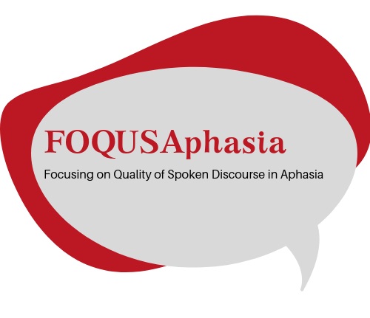
Acknowledgments and Disclosures
Some of these studies have been grant supported, and those grants are listed with each study
No other financial or non-financial disclosures
Thank you
Stakeholders, colleagues
myaamiaki (Miami), Lënape (Delaware), Bodwéwadmik (Potawatomi), and saawanwa (Shawnee) people, on whose ancestral homelands and resources Indiana University Bloomington is built

Slide 3
Intro
Study 1
Study 2
Discussion
“discourse” = language beyond a single simple clause used for a specific purpose (Armstrong, 2000)
Picture naming, word and sentence repetition
Single word and other highly constrained tasks
Conversation, spontaneous and free speech
Everyday communication: a multiword, complex environment, highly personalized & functional
Monologic discourse
Semi-structured tasks, more reminiscent of everyday communication
Domesticated
The Wild
high
Experimental Constraint
low
Each can contain multimodal components (e.g., gesture)

Slide 4
Today’s talk
Overview of three studies we’ve recently completed
Discussion of current findings and implications
Big emphasis on discussion – I want to hear from you!

Slide 5
Why do we need to improve measurement of spoken discourse in aphasia?
Intro
Study 1
Study 2
Discussion
Few validated assessments evaluate discourse
Current assessments emphasize language in isolation
Several benefits to acquiring and analyzing discourse:
simultaneous analysis across language levels and dimensions of use
demonstrate language impairments in the mildest forms of aphasia → be a critical evidence point for providing continued clinical services
Presently, analyzing discourse is not the standard in clinic or research
Yet → both researchers and clinicians want the tools & materials to be able to elicit, score, and interpret it! Stark et al., 2021

Slide 6
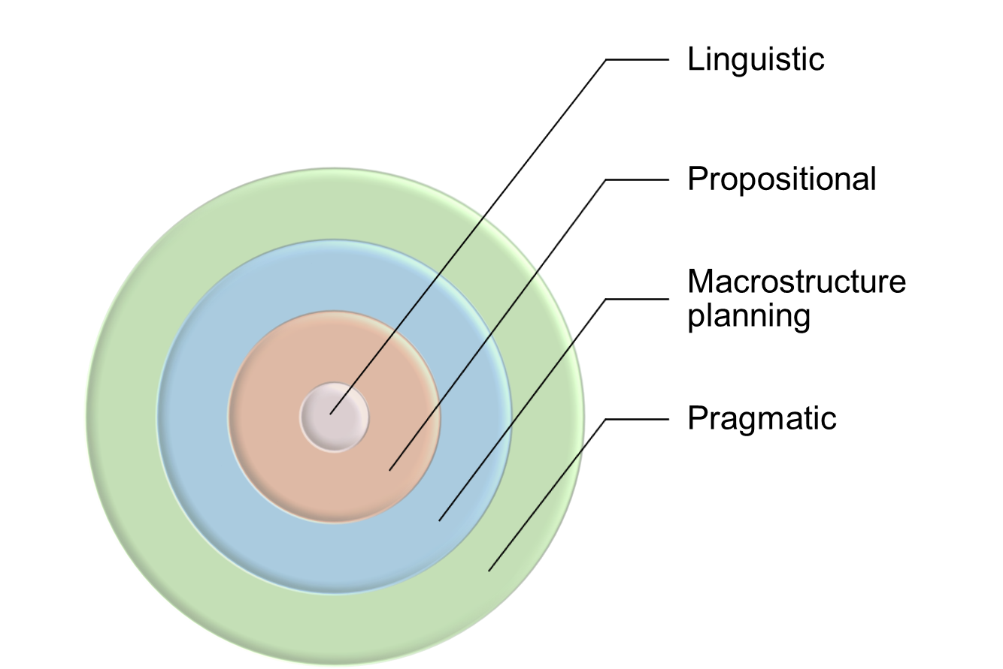
Many different components to discourse
Intro
Study 1
Study 2
Discussion
syntax, lexical semantics, lemma and lexemes, and phonology
sequencing, sentence semantics, cohesion, and semantic content
structure, gist, story content, framing, and coherence
context, interpersonal factors, interactional factors, and influences from situational and external influences
Dipper et al., 2021

Slide 7
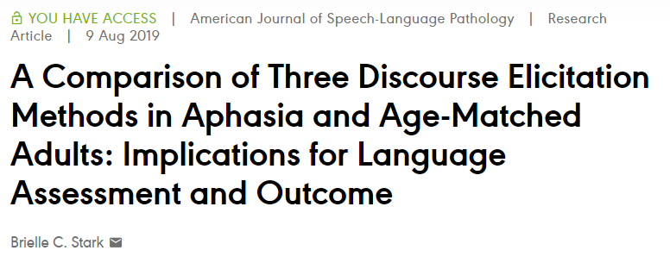
Task/context influence on language in aphasia
Intro
Study 1
Study 2
Discussion
AphasiaBank
(aphasia.talkbank.org)
Goal: describe and contrast language produced in response to different elicitation methods across speaker groups (control, aphasia) and by aphasia type and/or severity
Participants
N~300 with aphasia (many types represented; ages 25 – 91; all with chronic aphasia)
N~200 neurotypical control (differed by task; similar age, education)

Slide 8
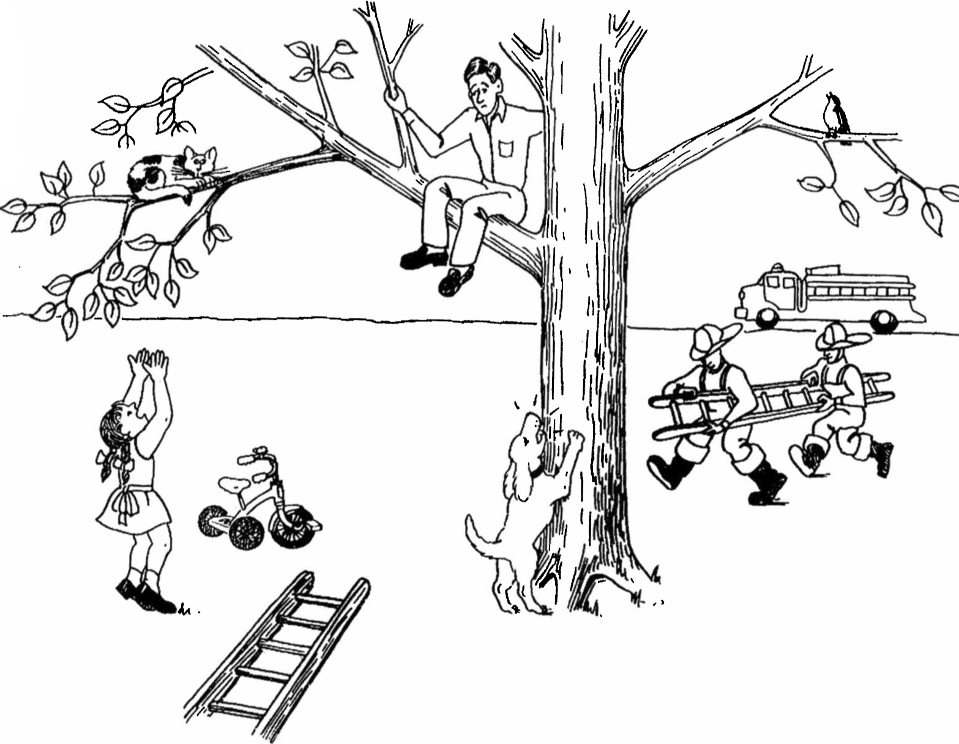
Task/context influence on language in aphasia
Intro
Study 1
Study 2
Discussion
Methods
Extracted linguistic variables as a proportion of total words:
word class (open, closed)
part of speech (i.e., noun, verb)
morphosyntactic form (i.e., tense)
Five tasks: picture description, picture sequence, narrative (x2), procedural
Analysis
Between-class analysis: reduction to lower dimensional space [reflect distances in high-dimensional space] → categories that have similar language composition are plotted near to each other, while categories that have dissimilar language composition are positioned farther away

Slide 9
Unsurprisingly: tasks have unique linguistic profile in age-matched neurotypical peers
Intro
Study 1
Study 2
Discussion
No real “perfect” interpretation of axis 1 vs. axis 2 for variables
Main panel shows projections of task means (labeled boxes) and individual samples (points) onto the BCA axes.
While there is within-task variance, the language produced in response to the different tasks are quite distinct and differentiable by task genre
Stark & Fukuyama, LCN 2021
Dot = participant’s language sample

Slide 10
Intro
Study 1
Study 2
Discussion
Tasks within the same genre demonstrate the most similar linguistic profile (as expected)
Stark & Fukuyama, LCN 2021

Slide 11
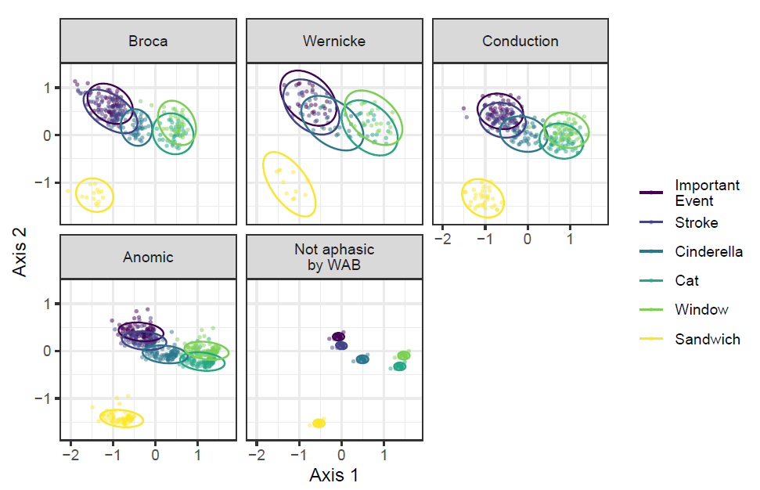
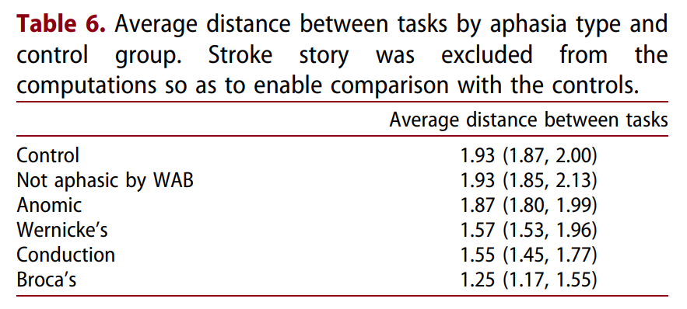
Persons with aphasia also show this pattern, but differs by aphasia type & severity
Intro
Study 1
Study 2
Discussion
Milder types of aphasia → look more like peers without aphasia
Note that variance within groups also increased as distances decreased
Stark & Fukuyama, LCN 2021
Dot = participant’s language sample

Slide 12
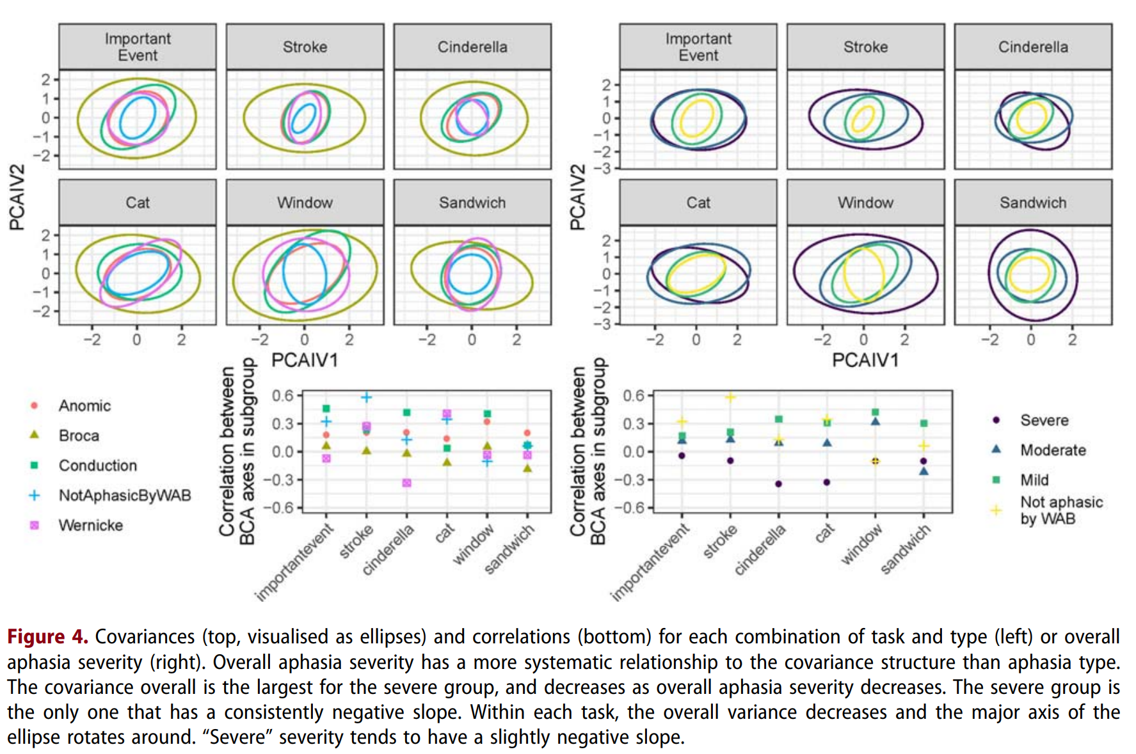
More severe aphasia (regardless of aphasia type) → less distance between tasks language tends to look “alike” no matter the task
Intro
Study 1
Study 2
Discussion
Stark & Fukuyama, LCN 2021

Slide 13
Task differences in linguistic structure reduced in aphasia, largely driven by severity
Intro
Study 1
Study 2
Discussion
More severe aphasia →
more severe lexical retrieval issues →
limited language availability →
similar microlinguistic structure regardless of task/frame
Importance of a variety of tasks and genres when evaluating language structure in milder aphasia
Likely equally large differences existing between and within less restrained tasks like free conversation
Executive function / planning? Memory demands? What else is going on?
Limitation: this isn’t looking at macrostructural or pragmatic levels of discourse; we are limited to monologue only
Similar language in more severe aphasia may not hold true for conversation (see Leaman & Edmonds 2023)
Clinical implications?

Slide 14
Test-retest reliability of commonly used discourse measures (linguistic & propositional components) and the relationship with task
Intro
Study 1
Study 2
Discussion
Reliability of a measure is crucial because of everyday language variability in individuals with aphasia (e.g., Herbert et al., 2008; Hula & McNeil, 2008)
A measure that varies widely within subjects in a short interval (i.e., test/retest) is not stable enough to be used as a clinically meaningful outcome or assessment measure
Some of the reason we may not find ‘generalization’ to discourse is because we aren’t analyzing a reliable discourse metric → the variance is overcoming the statistical ability to identify change
Purpose: Identify test-retest reliability of discourse in individuals with aphasia and prospectively matched adults without brain damage across a battery of common tasks

Slide 15
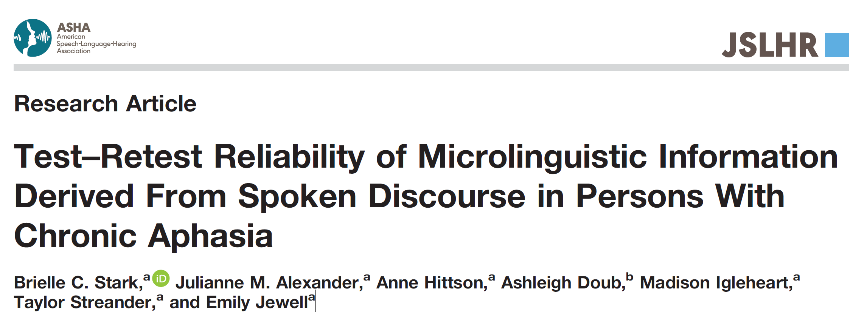
Basic methodology
Intro
Study 1
Study 2
Discussion
Subjects
N=25 individuals with aphasia
N=24 prospectively matched controls (despite best efforts – they ended up being significantly younger and more often female)
Methodology
Test then retest within 10 +/- 3 days (average length difference: 7 days)
AphasiaBank spontaneous discourse protocol
Project pre-registered prior to analysis: https://osf.io/y9qsc
Analyses
Primary DVs: percentage of correct information units (%CIUs) [informativeness] and CIUs/min [efficiency]
Secondary DVs: variety of lexicosemantic and morphosyntactic measures

Slide 16
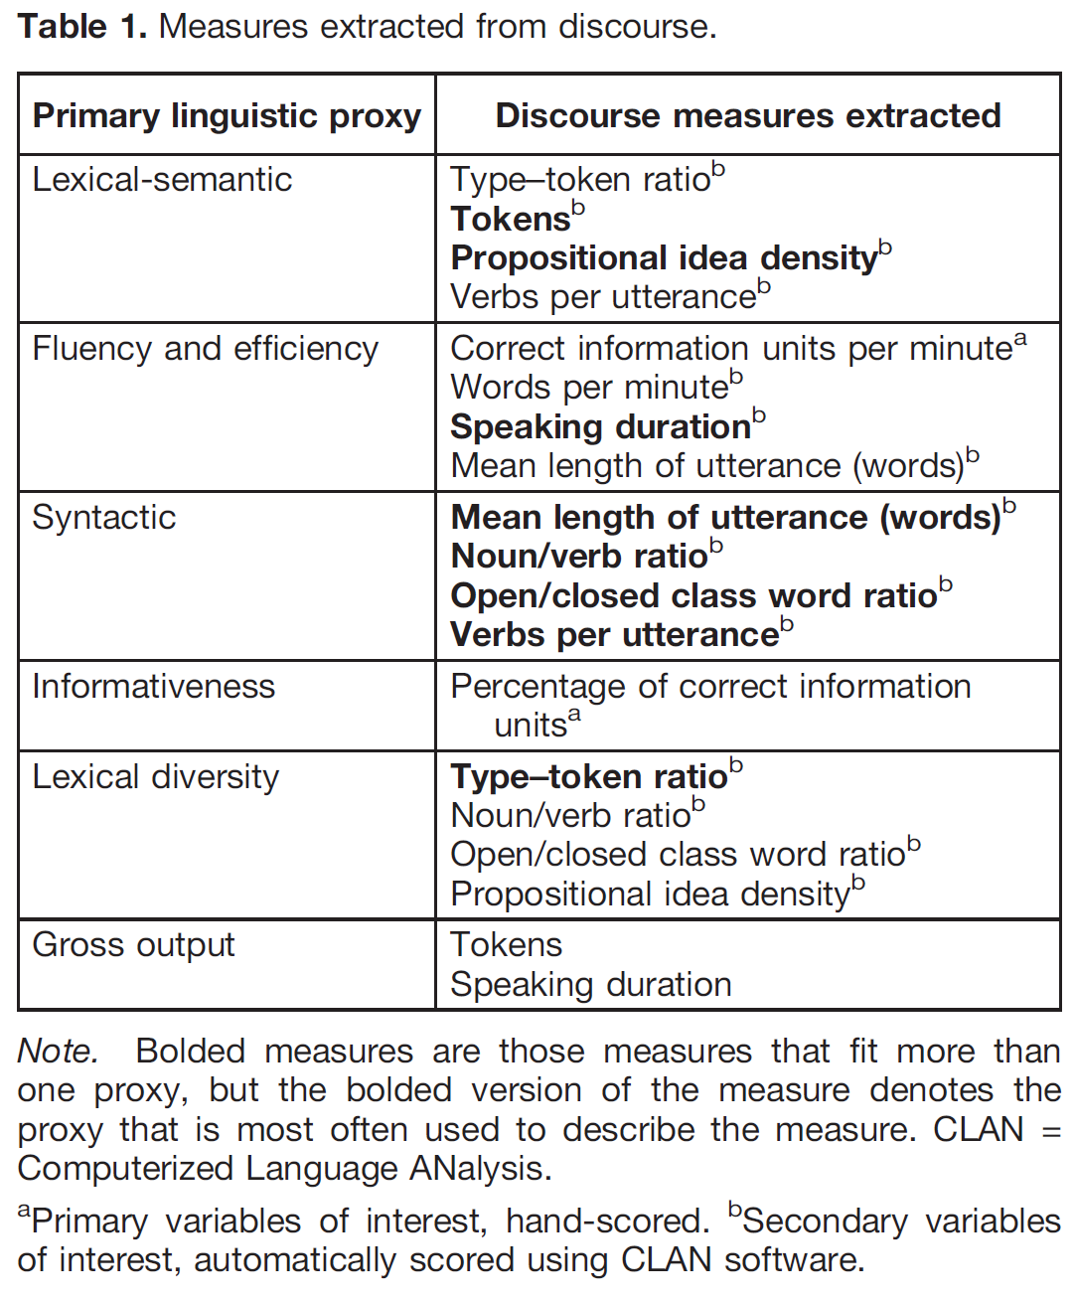
Intro
Study 1
Study 2
Discussion

Slide 17
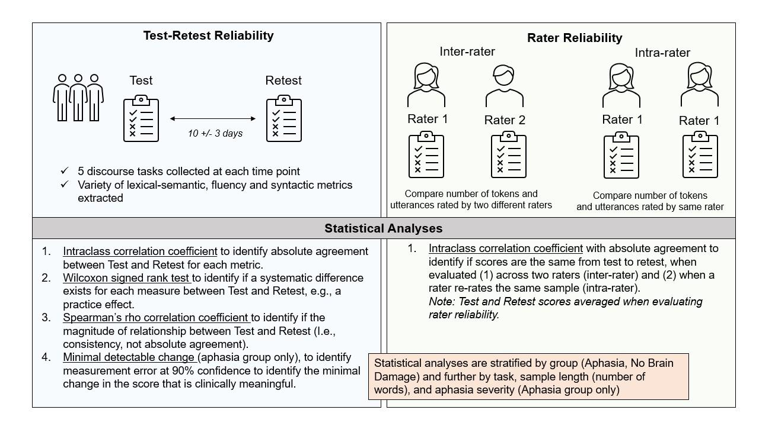
Intro
Study 1
Study 2
Discussion

Slide 18
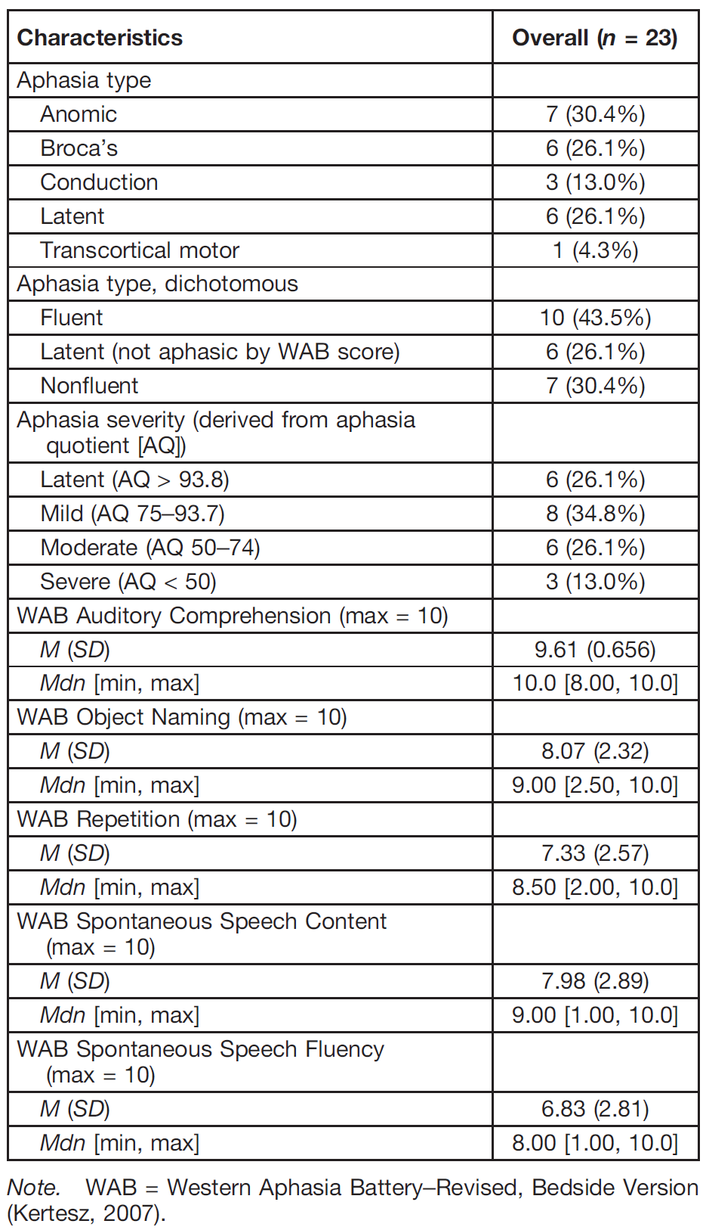
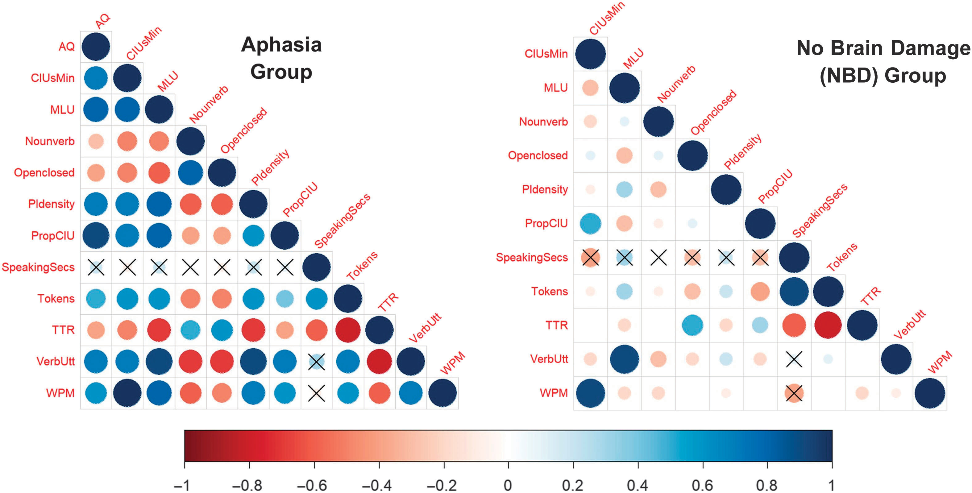
Intro
Study 1
Study 2
Discussion

Slide 19
When speaking data is averaged across tasks
Intro
Study 1
Study 2
Discussion
Relationship magnitude
Sig. diff between test & retest
Absolute agreement / reliability
Standard error of measurement & minimal detectable change 90%
MDC based on specific group data, not generalizable outside of this sample
E.g: this group would need to increase CIUs/min by 15.79 for clin. change at 90%
Generally acceptable agreement, especially lexical/informativeness and fluency/efficiency *not so great* syntactic
Most have strong positive relationship & no significant difference at Retest (but: see yellow boxes)

Slide 20
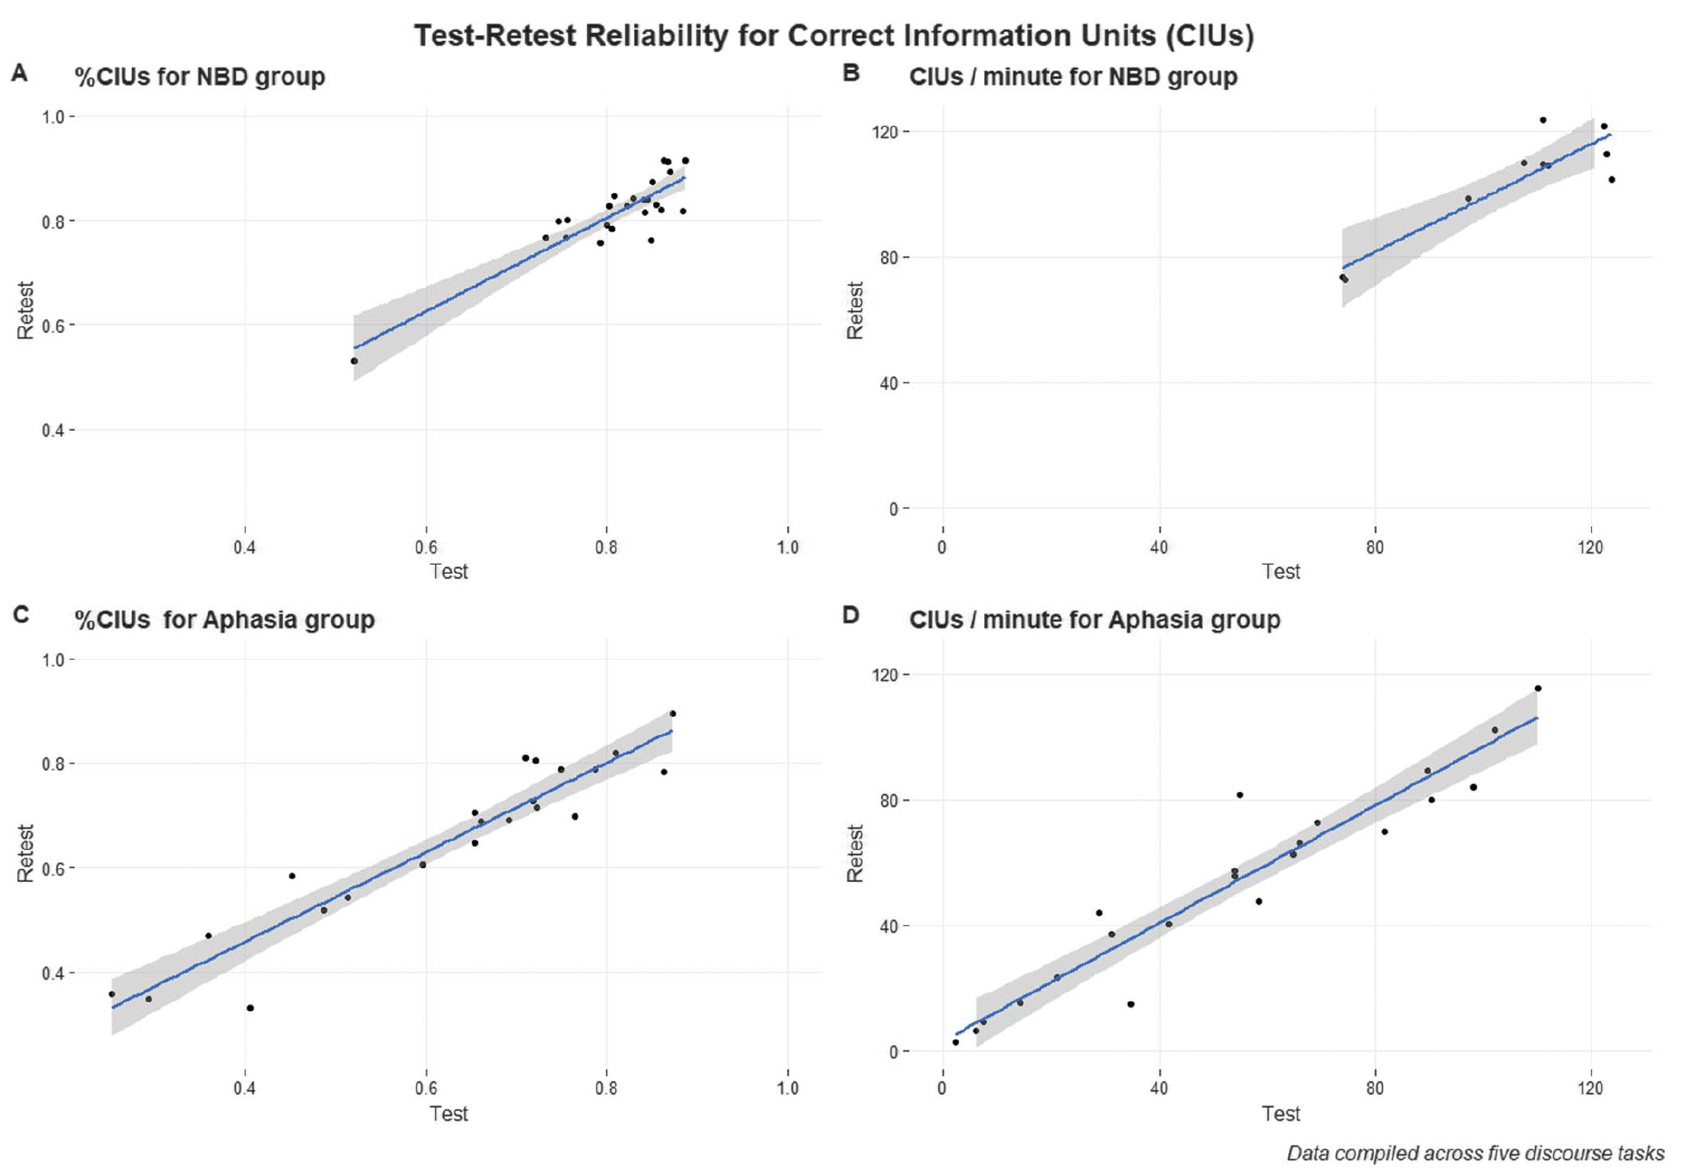
Good-to-excellent %CIUs and CIUs/min when collapsing across tasks, for both groups
Intro
Study 1
Study 2
Discussion

Slide 21
Intro
Study 1
Study 2
Discussion

Slide 22
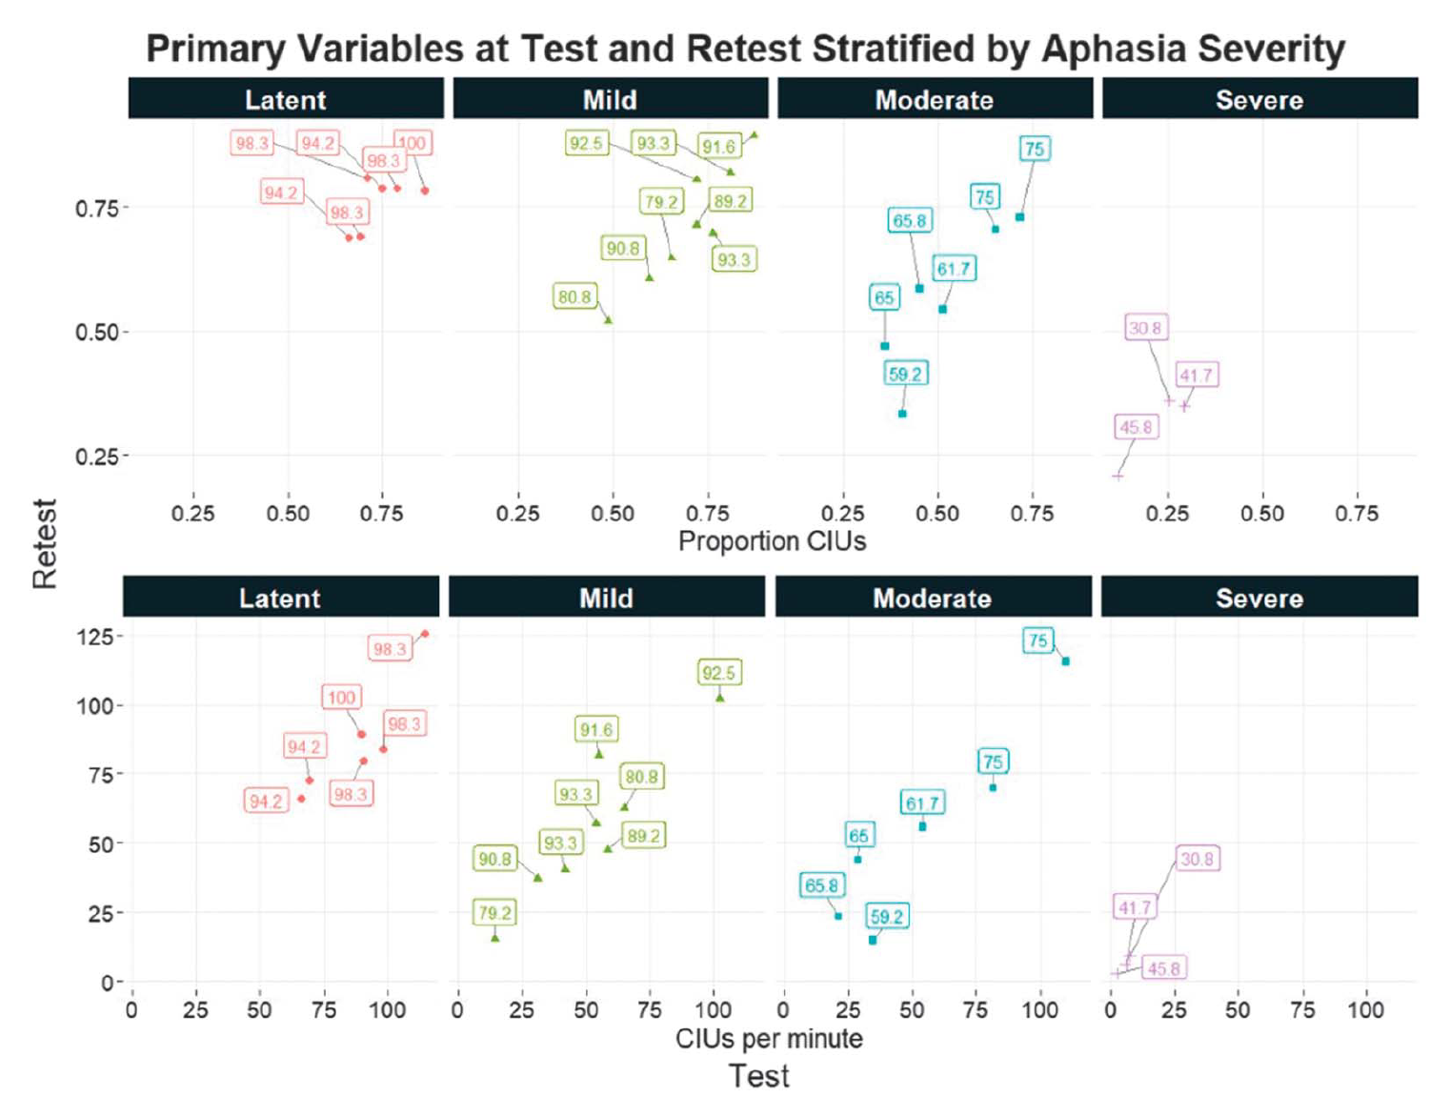
Intro
Study 1
Study 2
Discussion
Relatively small influence of aphasia severity on primary variables (averaged across tasks)
** note all slopes are positive and relatively linear [dashed lines]

Slide 23
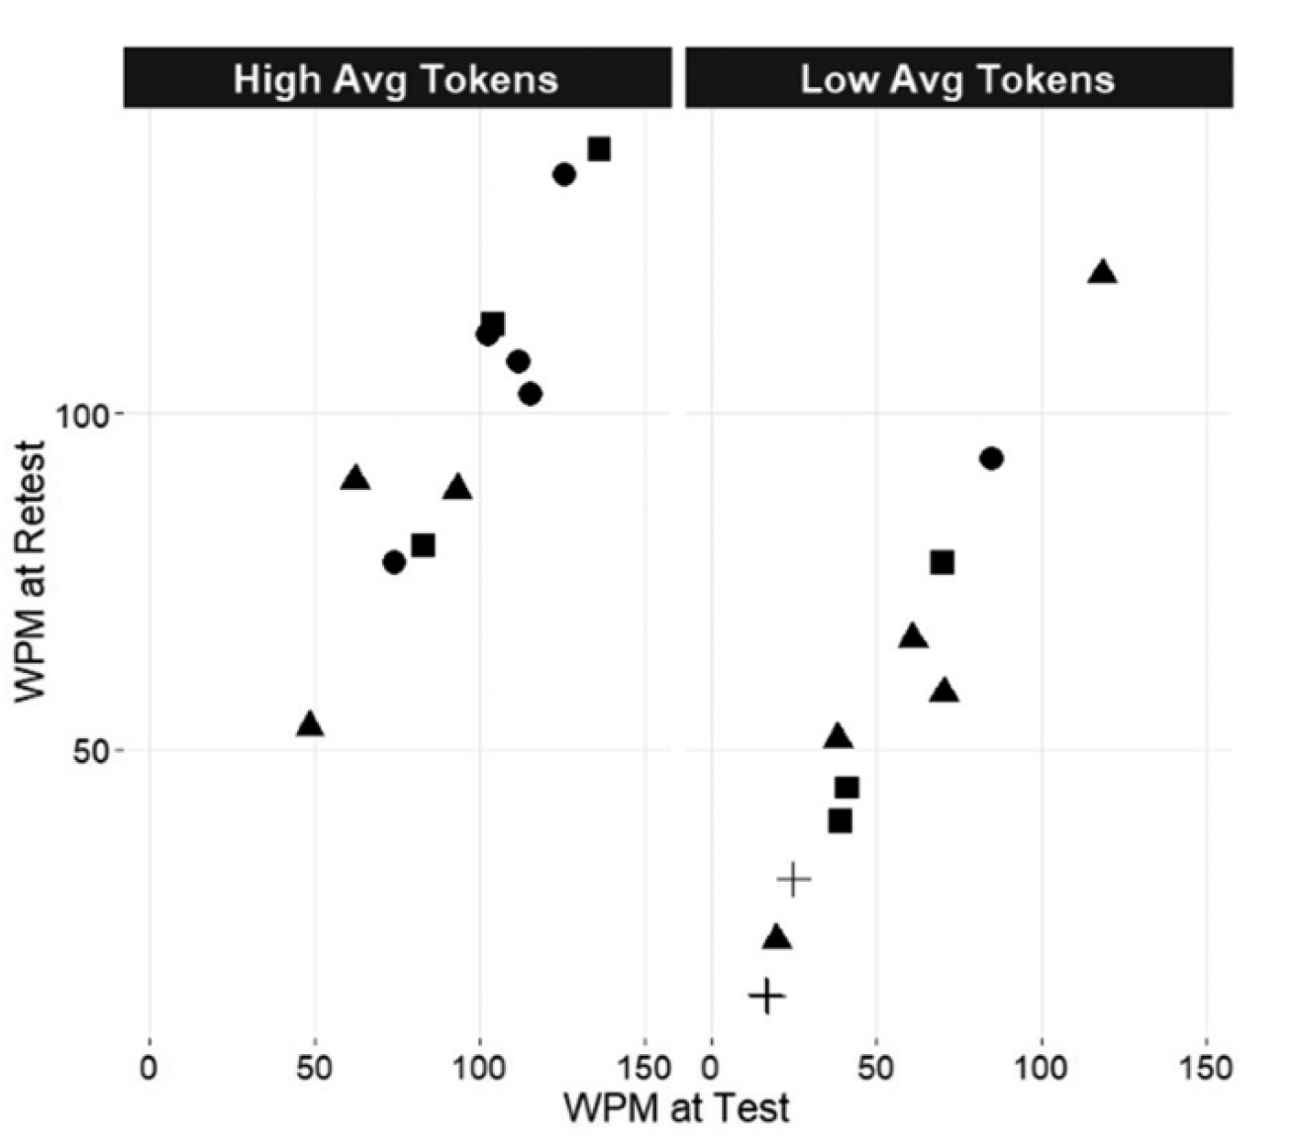
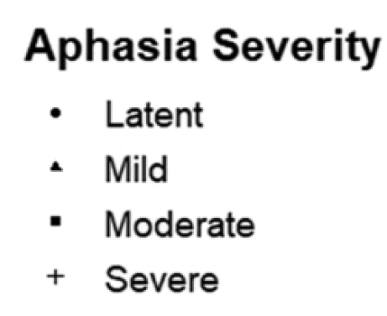
Intro
Study 1
Study 2
Discussion
Task length (words) also didn’t have a large impact on reliability (when language averaged across tasks)
[dashed line = slopes]

Slide 24
Reliability varies by task & group & metric
Intro
Study 1
Study 2
Discussion
Summary:
Fluency/efficiency & lexical / informativeness proxies most reliable across tasks for both groups
Aphasia group more reliable across tasks than NBD group
Count = # acceptable metrics summed across tasks
11 Aphasia
6 NBD
9 Aphasia
7 NBD
11 Aphasia
0 NBD

Slide 25
By task
Reliability is highly task, metric & group dependent
Some interaction with aphasia severity and gross output (words), but these explain far less variance than task itself
7 Aphasia
2 NBD
8 Aphasia
3 NBD
4 Aphasia
2 NBD
6 Aphasia
3 NBD
6 Aphasia
3 NBD

Slide 26
Major conclusions
Intro
Study 1
Study 2
Discussion
Lexical/informativeness and fluency/efficiency discourse metrics show good-to-excellent test-retest reliability in both groups
these measures are likely most sensitive to demonstrating change after tx
don’t confuse a ‘reliable’ measure in a control group to also be reliable in an aphasia group and vice versa
test-retest reliability is important to evaluate for each discourse metric across tasks and for each task
don’t assume that a measure will be reliable across different tasks
important to establish a double baseline or otherwise stable baseline (e.g., multiple baseline, single-subject design)

Slide 27
what’s next?
Intro
Study 1
Study 2
Discussion
By improving how and what we measure in discourse, we can improve its use in assessment and treatment clinically, and improve the robustness of research concerning discourse
Larger test-retest design (ongoing: R01DC008524)
Work closely with key stakeholders (individuals with aphasia, speech-language pathologists) to improve existing spoken discourse assessment & analysis tools to improve validity and implementation (collaborating with Dr. Sarah Grace Dalton @ Marquette)
Synthesize multimodal work with spoken discourse work (see Stark & Cofoid 2021 for gesture-related research by task)
Synthesize inner speech work with spoken discourse work (see Stark et al., 2017; newly accepted Alexander et al., forthcoming in Aphasiology!)
What else?

Slide 28
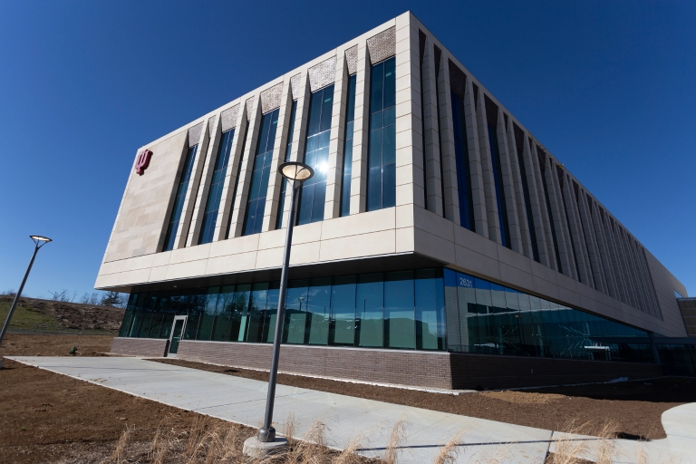
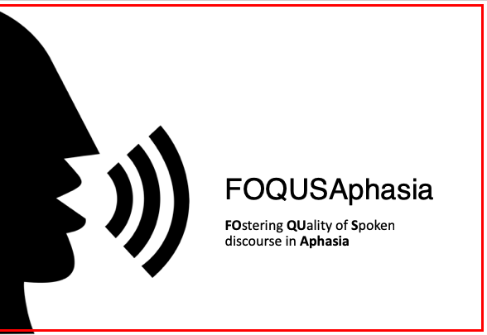
My lab
My funding bodies: ASHFoundation, NIDILRR, NIH
FOQUSAphasia & AphasiaBank team
Clinicians, individuals with aphasia, my mentors
Questions & chat time

Slide 29
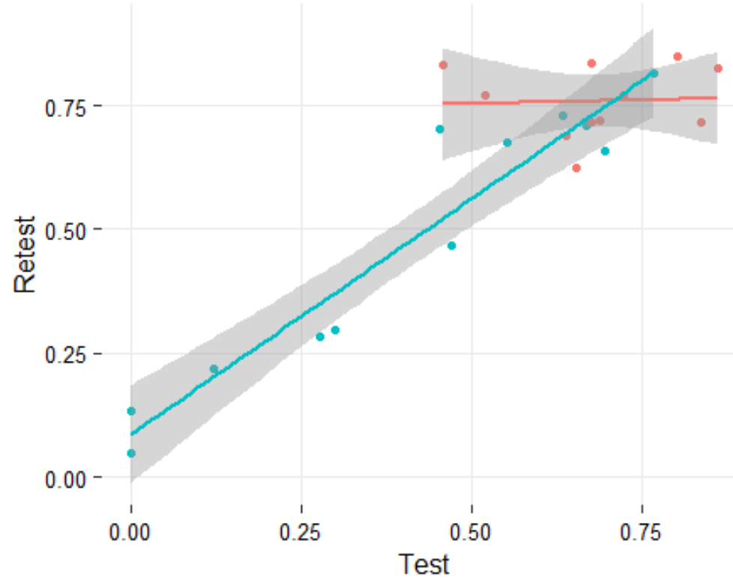
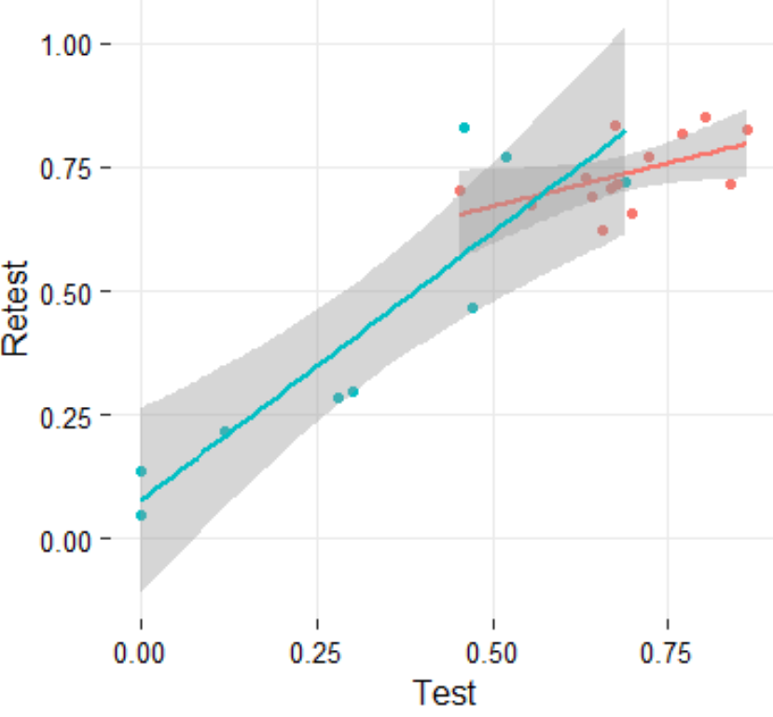
Intro
Study 1
Study 2
Discussion
%CIUs for CINDERELLA ONLY, Aphasia group
Red = long sample (>median [529 tokens])
Blue = shorter sample (<= median)
Sample Length
%CIUs for CINDERELLA ONLY, Aphasia group
Red = less severe (>75 AQ)
Blue = more severe (<= 75 AQ)
Aphasia Severity
longer samples (& more mild aphasia) seem to produce less reliable CIUs for *Cinderella* (not necessarily the case for every task)

Slide 30
Sample length’s influence on reliability is task dependent CHECK THAT THIS IS STILL TRUE & CHECK GRAPHS
Intro
Study 1
Study 2
Discussion
%CIUs across tasks, NBD group
Red = long sample (>median [192])
Blue = shorter sample (<= median)
Cat Task Only
(median = 311 words)
Cinderella Task Only
(median = 1022 words)
Longer samples seem to produce more reliable CIUs for controls, albeit small difference

